Slide 1
OPTIMAL CODE

Slide 2
we proved that any codeword set that satisfies the prefix condition has to satisfy the Kraft inequality and that the Kraft inequality is a sufficient condition for the existence of a codeword set with the specified set of codeword lengths.
We now consider the problem of finding the prefix code with the minimum expected length
Encode source X with pdf pi
Find code length li to minimize expected code length L
Uniquely decodable code should satisfy Kraft-McMillan inequality

Slide 3
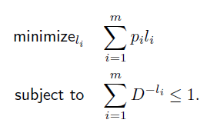

Slide 4

This is equivalent to finding the set of lengths l1, l2, . . . , lm satisfying the Kraft inequality.
The expected length L of any instantaneous D-ary code for a random variable X is greater than or equal to the entropy HD(X); that is,

Slide 5
HUFFMAN CODES
An optimal (shortest expected length) prefix code for a given distribution can be constructed by a simple algorithm discovered by Huffman
Consider a random variable X taking values in the set
X = {1, 2, 3, 4, 5} with probabilities 0.25, 0.25, 0.2, 0.15, 0.15, respectively.
We expect the optimal binary code for X to have the longest codewords assigned to the symbols 4 and 5.
These two lengths must be equal, since otherwise we can delete a bit from the longer codeword and still have a prefix code, but with a shorter expected length.

Slide 6
In general, we can construct a code in which the two longest codewords differ only in the last bit.
For this code, we can combine the symbols 4 and 5 into a single source symbol, with a probability assignment 0.30.
Proceeding this way, combining the two least likely symbols into one symbol until we are finally left with only one symbol, and then assigning codewords to the symbols,

Slide 7
Encoding messages
Encode a message composed of a string of characters
Codes used by computer systems
ASCII
uses 8 bits per character
can encode 256 characters
Unicode
16 bits per character
can encode 65536 characters
includes all characters encoded by ASCII
ASCII and Unicode are fixed-length codes
all characters represented by same number of bits

Slide 8
Problems
Suppose that we want to encode a message constructed from the symbols A, B, C, D, and E using a fixed-length code
How many bits are required to encode each symbol?
at least 3 bits are required
2 bits are not enough (can only encode four symbols)
How many bits are required to encode the message DEAACAAAAABA?
there are twelve symbols, each requires 3 bits
12*3 = 36 bits are required

Slide 9
Drawbacks of fixed-length codes
Wasted space
Unicode uses twice as much space as ASCII
inefficient for plain-text messages containing only ASCII characters
Same number of bits used to represent all characters
‘a’ and ‘e’ occur more frequently than ‘q’ and ‘z’
Potential solution: use variable-length codes
variable number of bits to represent characters when frequency of occurrence is known
short codes for characters that occur frequently

Slide 10
Advantages of variable-length codes
The advantage of variable-length codes over fixed-length is short codes can be given to characters that occur frequently
on average, the length of the encoded message is less than fixed-length encoding
Potential problem: how do we know where one character ends and another begins?
not a problem if number of bits is fixed!
A = 00
B = 01
C = 10
D = 11
0010110111001111111111
A C D B A D D D D D

Slide 11
Prefix property
A code has the prefix property if no character code is the prefix (start of the code) for another character
Example:
000 is not a prefix of 11, 01, 001, or 10
11 is not a prefix of 000, 01, 001, or 10 …
Symbol | Code
P | 000
Q | 11
R | 01
S | 001
T | 10
01001101100010
R S T Q P T

Slide 12
Code without prefix property
The following code does not have prefix property
The pattern 1110 can be decoded as QQQP, QTP, QQS, or TS
Symbol | Code
P | 0
Q | 1
R | 01
S | 10
T | 11

Slide 13
Problem
Design a variable-length prefix-free code such that the message DEAACAAAAABA can be encoded using 22 bits
Possible solution:
A occurs eight times while B, C, D, and E each occur once
represent A with a one bit code, say 0
remaining codes cannot start with 0
represent B with the two bit code 10
remaining codes cannot start with 0 or 10
represent C with 110
represent D with 1110
represent E with 11110

Slide 14
Encoded message
DEAACAAAAABA
Symbol | Code
A | 0
B | 10
C | 110
D | 1110
E | 11110
1110111100011000000100
22 bits

Slide 15
Another possible code
DEAACAAAAABA
Symbol | Code
A | 0
B | 100
C | 101
D | 1101
E | 1111
1101111100101000001000
22 bits

Slide 16
Better code
DEAACAAAAABA
Symbol | Code
A | 0
B | 100
C | 101
D | 110
E | 111
11011100101000001000
20 bits

Slide 17
What code to use?
Question: Is there a variable-length code that makes the most efficient use of space?
Variable-length coding (VLC) is one of the best-known entropy coding methods.
Answer: Yes!

Slide 18
Huffman coding tree
Binary tree
each leaf contains symbol (character)
label edge from node to left child with 0
label edge from node to right child with 1
Code for any symbol obtained by following path from root to the leaf containing symbol
Code has prefix property
leaf node cannot appear on path to another leaf
note: fixed-length codes are represented by a complete Huffman tree and clearly have the prefix property

Slide 19
Building a Huffman tree
Find frequencies of each symbol occurring in message
Begin with a forest of single node trees
each contain symbol and its frequency
Do recursively
select two trees with smallest frequency at the root
produce a new binary tree with the selected trees as children and store the sum of their frequencies in the root
Recursion ends when there is one tree
this is the Huffman coding tree

Slide 20
Example
Build the Huffman coding tree for the message
This is his message
Character frequencies
Begin with forest of single trees
A | G | M | T | E | H | _ | I | S
1 | 1 | 1 | 1 | 2 | 2 | 3 | 3 | 5
1
1
1
1
2
2
3
3
5
A
G
M
T
E
H
_
I
S

Slide 21
Step 1
2
1
1
1
1
2
2
3
3
5
A
G
M
T
E
H
_
I
S

Slide 22
Step 2
2
2
1
1
1
1
2
2
3
3
5
A
G
M
T
E
H
_
I
S

Slide 23
Step 3
2
2
4
1
1
1
1
2
2
3
3
5
A
G
M
T
E
H
_
I
S

Slide 24
Step 4
4
2
2
4
1
1
1
1
2
2
3
3
5
A
G
M
T
E
H
_
I
S

Slide 25
Step 5
4
2
2
4
6
1
1
1
1
2
2
3
3
5
A
G
M
T
E
H
_
I
S

Slide 26
Step 6
8
4
4
2
2
2
2
6
E
H
1
1
1
1
3
3
5
A
G
M
T
_
I
S

Slide 27
Step 7
8
11
4
4
6
5
S
2
2
2
2
3
3
E
H
_
I
1
1
1
1
A
G
M
T

Slide 28
Step 8
19
8
11
4
4
6
5
S
2
2
2
2
3
3
E
H
_
I
1
1
1
1
A
G
M
T

Slide 29
Label edges
19
0
1
8
11
0
1
0
1
4
4
6
5
0
1
0
1
0
1
S
2
2
2
2
3
3
0
1
0
1
E
H
_
I
1
1
1
1
A
G
M
T

Slide 30
Huffman code & encoded message
This is his message
S 11
E 010
H 011
_ 100
I 101
A 0000
G 0001
M 0010
T 0011
00110111011110010111100011101111000010010111100000001010

Slide 31
SHANNO FANO CODE
First the messages are ranked in a table in descending order of probability.
The table is then progressively divided into subsections of probability near equal as possible.
Binary 0 is attributed to the upper subsection and binary 1 to the lower subsection.
This process continues until it is impossible to divide any further, the following steps show the algorithmic procedure of Shannon – Fano encoding:
1-List the symbols in descending order of the probabilities.
2-Divide the table into as near as possible two equal values of probability.
3-Allocate binary 0 to the upper section and binary 1 to the lower section.
4-Divide both the upper section and the lower section into two.
5-Allocate binary 0 to the top half of each section and binary 1 to the lower half.
6-Repeat steps (4) and (5) until it is not possible to go any further.

Slide 33
UNICODE
UNICODE is a 16-bit code for representing alphanumeric data.
Developed by a consortia(An association or a combination, as of businesses, financial institutions, or investors, for the purpose of engaging in a joint venture.)
With 16 bits, can represent 216 or 65536 different symbols.
16 bits = 2 Bytes per character.
UNICODE used by Web browsers and Java these days.

Slide 34
ASCII CODE
The standard binary code for representation of alphanumeric characters is ASCII
•ASCII (American Standard for Information Interchange)
•It hands not only numbers but letters and special characters
•Uses 7 bits to code 128 characters
•In ASCII, every letter, number, and punctuation symbol has a corresponding
number, or ASCII code

Slide 35
Cont...
This code is a popular code used to represent information sent as character- based data.
It uses 7-bits to represent: › 94 Graphic printing characters. › 34 Non-printing characters
Some non-printing characters are used for text format (e.g. BS = Backspace, CR = carriage return)
Other non-printing characters are used for record marking and flow control (e.g. STX and ETX start and end text areas).

Slide 36
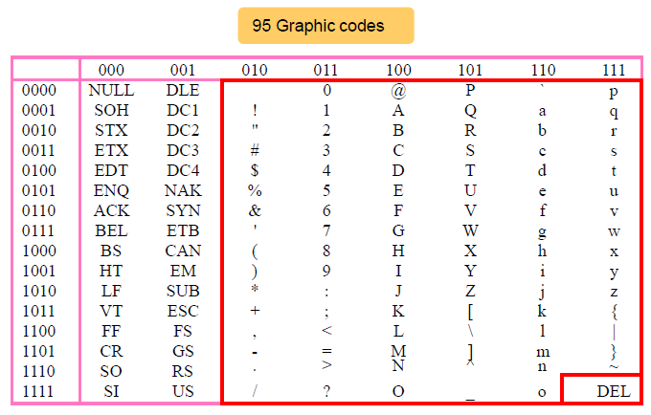

Slide 37
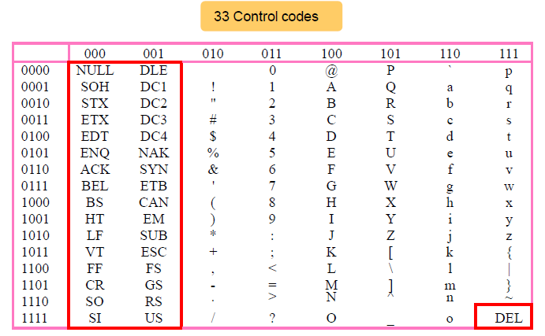

Slide 38
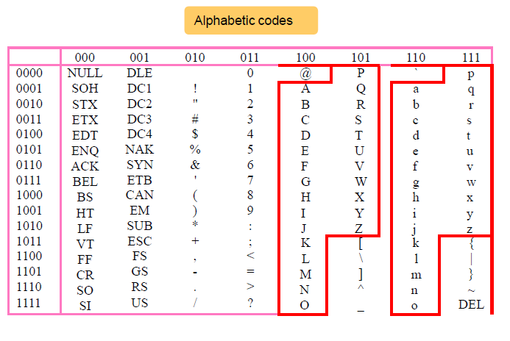

Slide 39
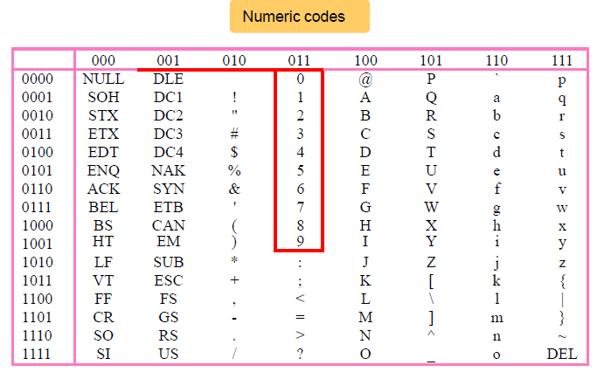

Slide 40
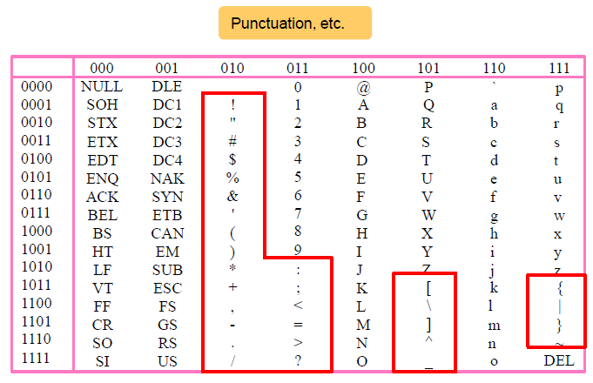

Slide 41
END

